Slide 1
TEACHEQUIP MANAGEMENT SYSTEM
INFORMATION TECHNOLOGY PROJECT 2
Huynh Tran Trung Hieu - 518H0090
To Thi Bich Tuyen – 518H0585

Slide 2
TABLE OF CONTENTS
01
02
03
4
Introduction
System Analysis And Design
Demo
Finish

Slide 3
INTRODUCTION
01
PROBLEM
SOLUTION

Slide 4
SYSTEM ANALYSIS AND DESIGN
Use case
CLASS DIAGRAM
ERD
02

Slide 5
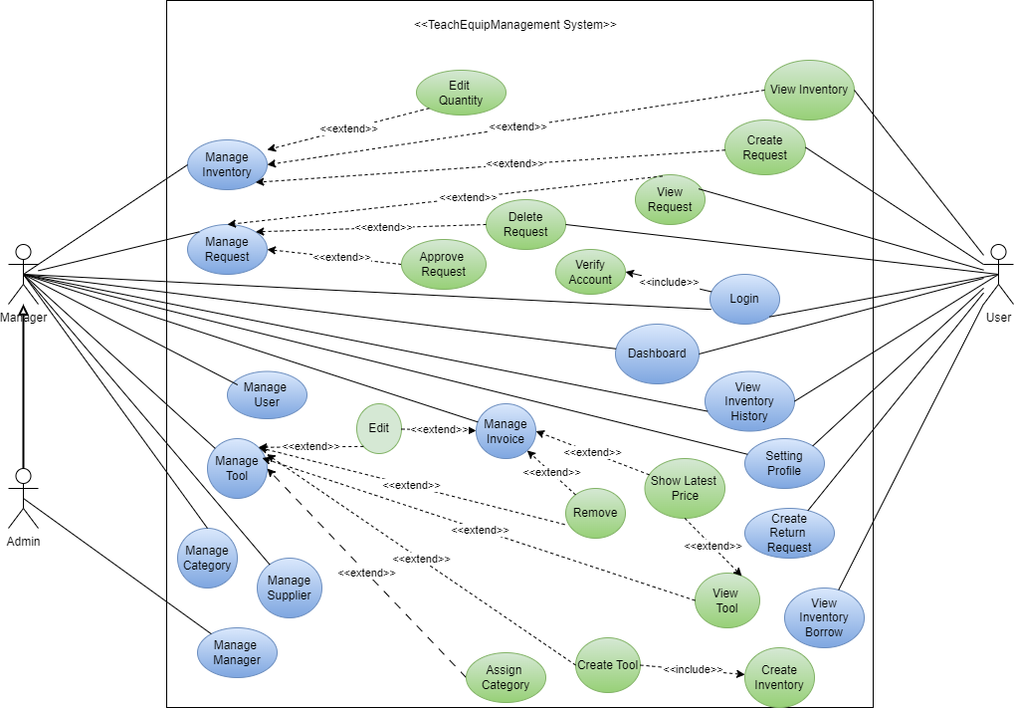
USE CASE
Manager
admin
user
Manage inventory, tool information, request, invoice, view dashboard, user account, dashboard.
Fully permission of manager and manage all managers.
View inventory, Create request to borrow/return tool.

Slide 6
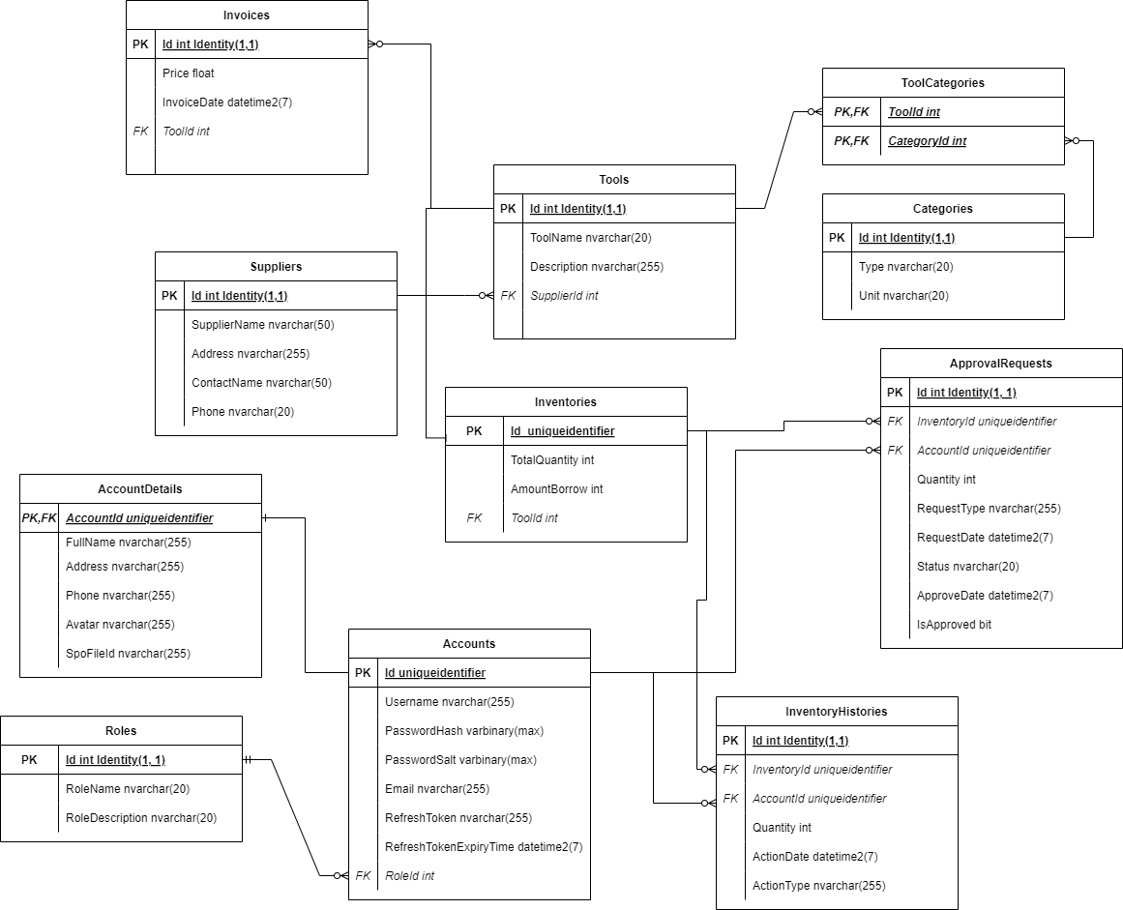
ERD

Slide 7
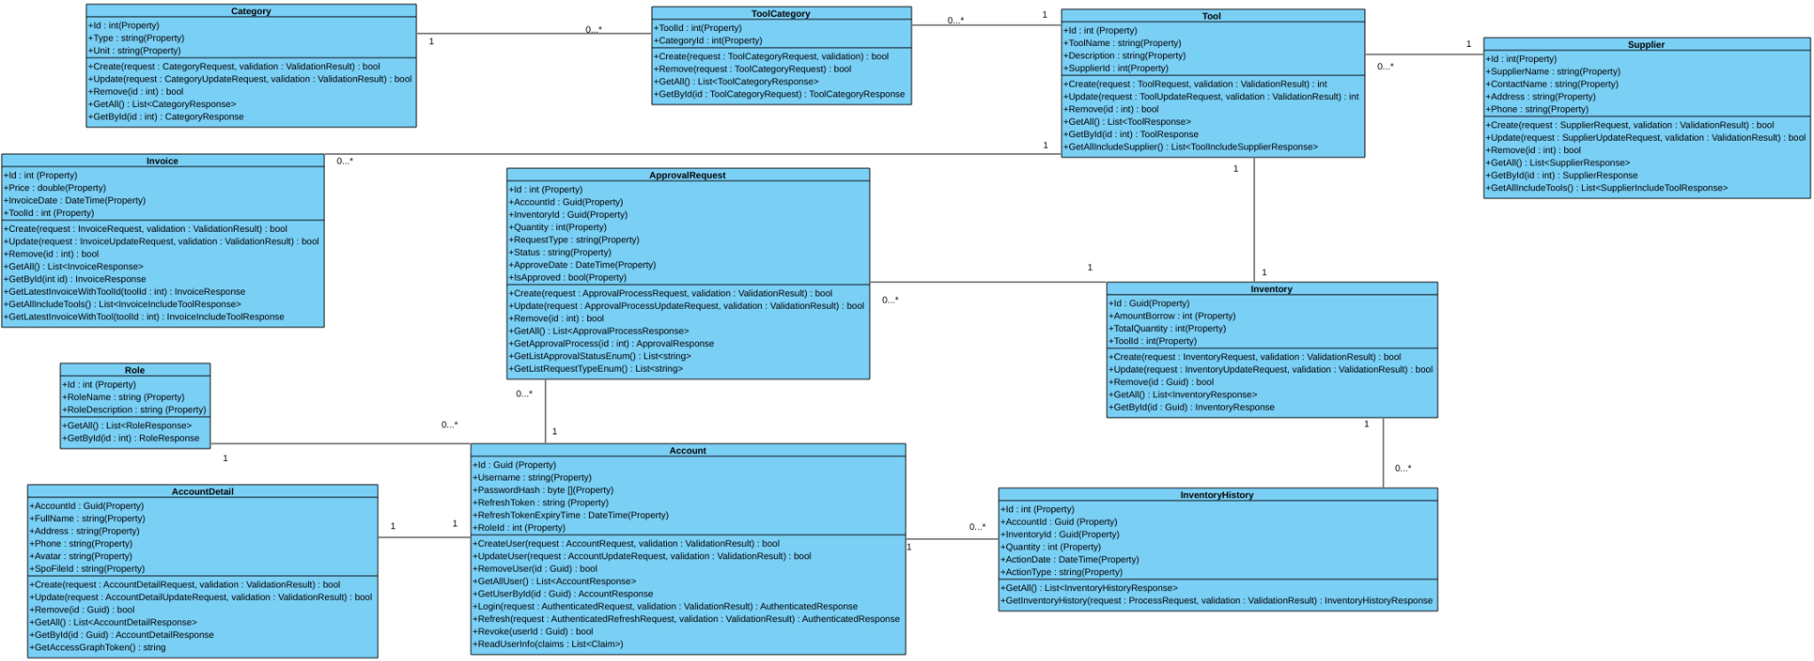
CLASS DIAGRAM

Slide 8

DEMO
03

Slide 9
THANKS!
04
Finish
Any Questions ?

